Slide 1
PLUS Tutorial: Ultrasound probe calibration using fCal
www.assembla.com/spaces/plus
Last Updated: 12/06/2012
By Paweena U-Thainual (Sue Sue)

Slide 2
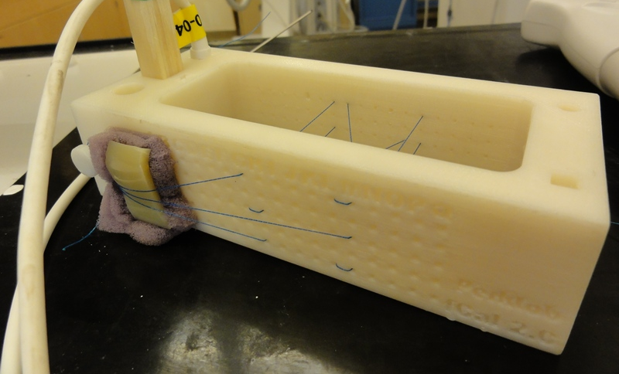
Concept
Goal: Determine the Image-to-Probe transform.
Use the correspondence of known wire positions in 3D and segmented wire positions in the US image.
N-wires are attached to a precisely manufactured calibration phantom (see image below) – see phantom building tutorial for instructions for building a phantom

Slide 3
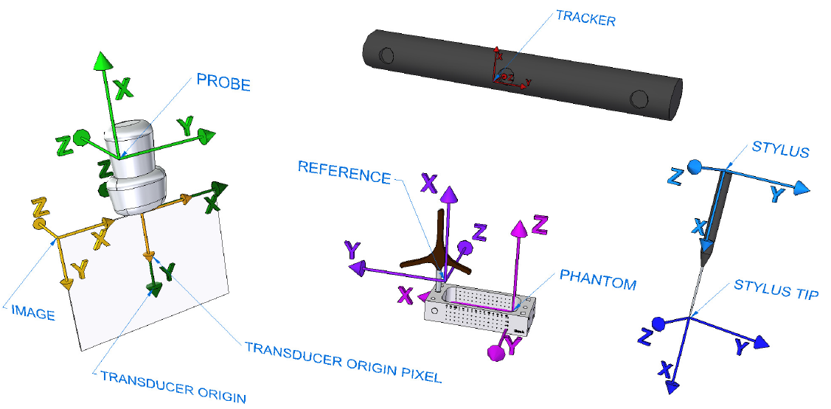
Coordinate systems
https://www.assembla.com/code/plus/subversion/nodes/trunk/PlusLib/docs/fCAL/CoordinateSystems/FreehandCalibration_CoordinateRepresentation.png

Slide 4
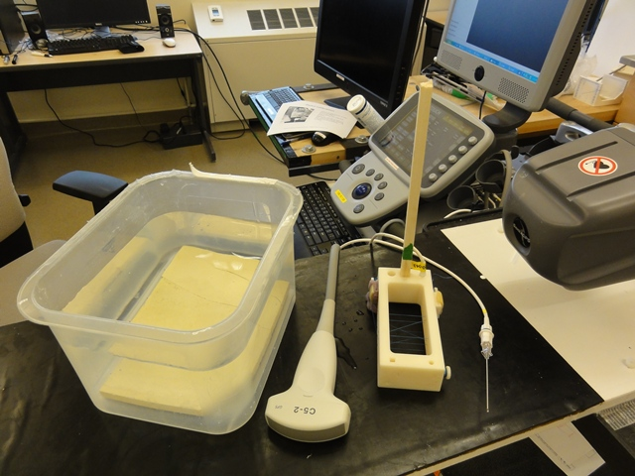
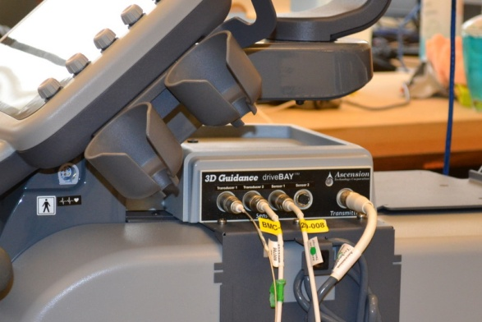
Hardware setup
Device set used in this tutorial:
Sonix Touch with GPS extension
Tracker tools
Probe
Reference
Stylus
fCal 2.x calibration phantom
Sonix GPS side cover removed for accessing all connectors

Slide 5
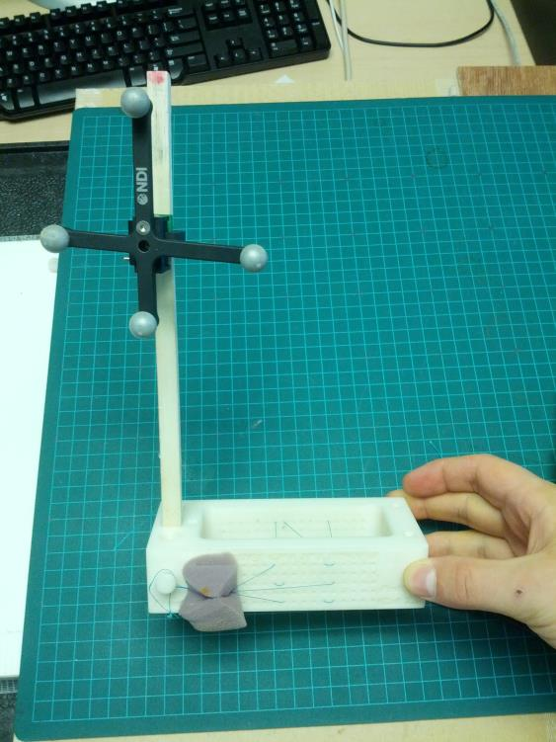
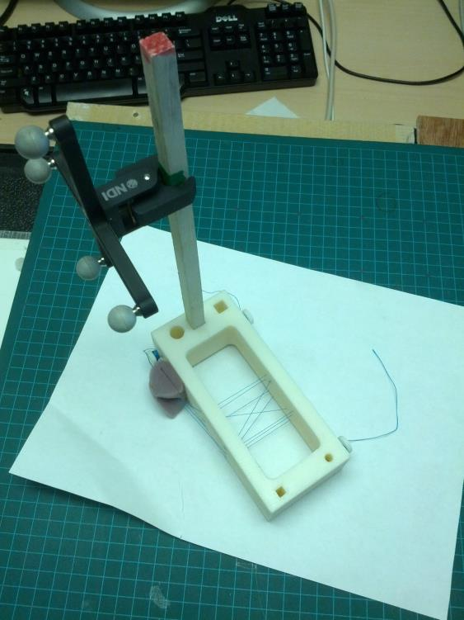
Hardware setup
Fixing the NDI Polaris markers on the phantom

Slide 6
Software setup
Download Plus applications releases from https://www.assembla.com/spaces/plus/wiki/Downloads
Start fCal.exe (PlusApp_x.x.x.xxxx/bin/fCal.exe)
Select your Device set as “SonixTouch GPS L14 + Reference + Stylus + Phantom x.x”
Click Connect
Check if all the devices are shown “OK”
Start Stylus calibration
Phantom registration
Temporal Calibration
Spatial calibration

Slide 7
Software setup
Download Plus applications releases from https://www.assembla.com/spaces/plus/wiki/Downloads
Start fCal.exe (PlusApp_x.x.x.xxxx/bin/fCal.exe)
Select your Device set as “SonixTouch GPS L14 + Reference + Stylus + Phantom x.x”
*L14 refers to .STL file for the probe only but not limits to the probe calibration, the user can use this config file for both C5 and L14

Slide 8
Software setup
Click Connect and check if all the devices are shown “OK”

Slide 9
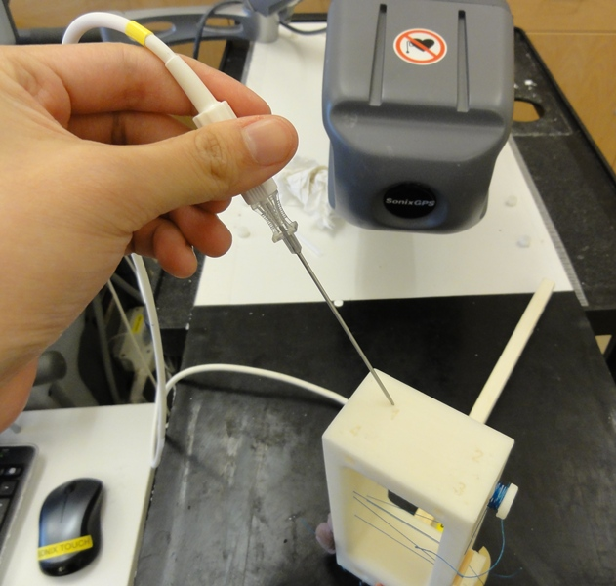
Stylus calibration
7
6
5
Attach an EM sensor to any pointing object.
Click “Start” fCal collects 200 different points. Stylus tip should be fixed to the reference while pivoting the sensor on a sphere surface
Save the calibration, select the directory to be saved

Slide 10
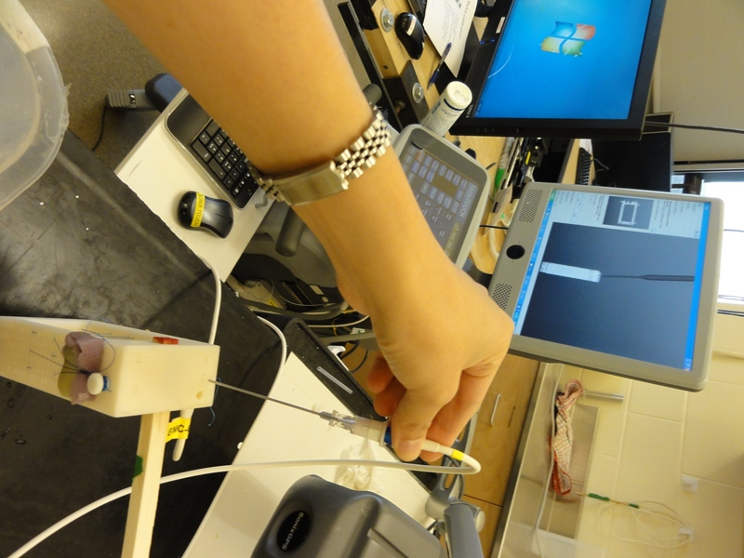
Phantom registration
Click “Record point” to register 8 predefined landmark points
Model points are defined in the configuration XML file
Tracked points are collected by the stylus. Then “save”

Slide 11
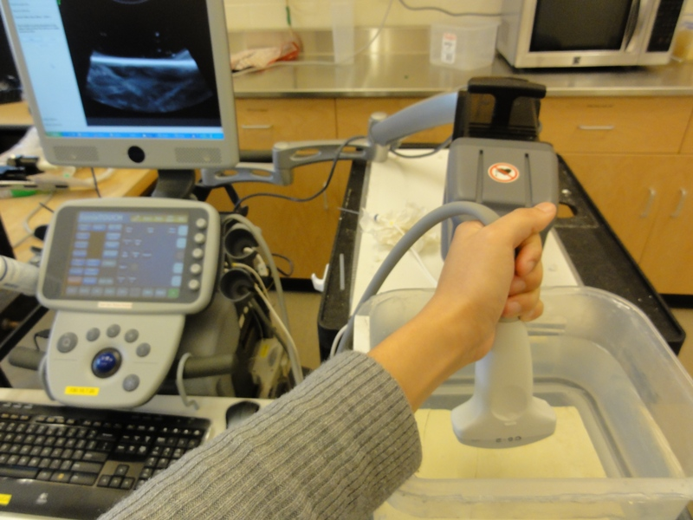
Temporal calibration
Place transducer in a water tank and slowly move the transducer up-down until a bright line appears on the screen. Check if the depth is set as desired (10 cm, 12 cm ,etc…)
Continue moving the transducer and then click “Start” module automatically collects 100 images for validation, 200 images for calibration. Images with failed registration are discarded.
Click “Show Plots” to check result.

Slide 12
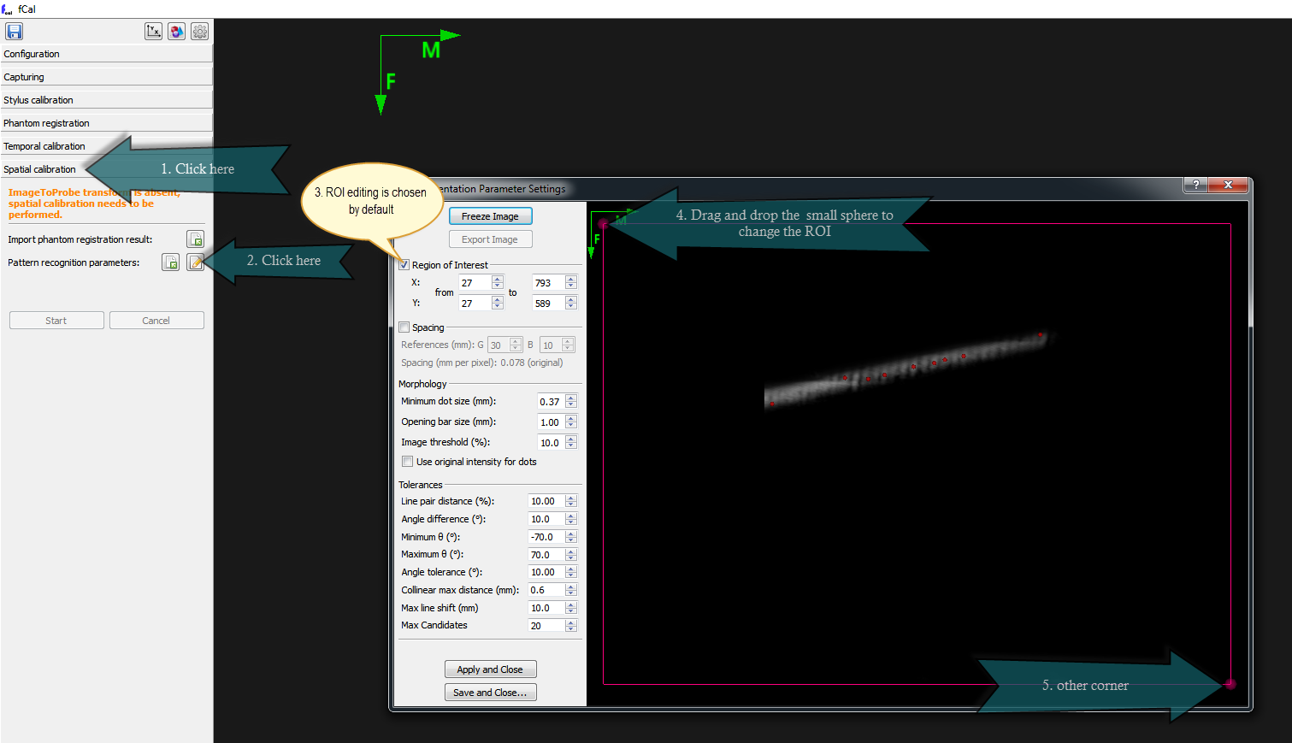
Temporal calibration
If you acquire data using a framegrabber then you have to define the region of interest to exclude text and other information in the image
The same ROI is used for temporal calibration as for spatial calibration, so the ROI can be set in the same place, in the Spatial calibration tab, as shown above

Slide 13
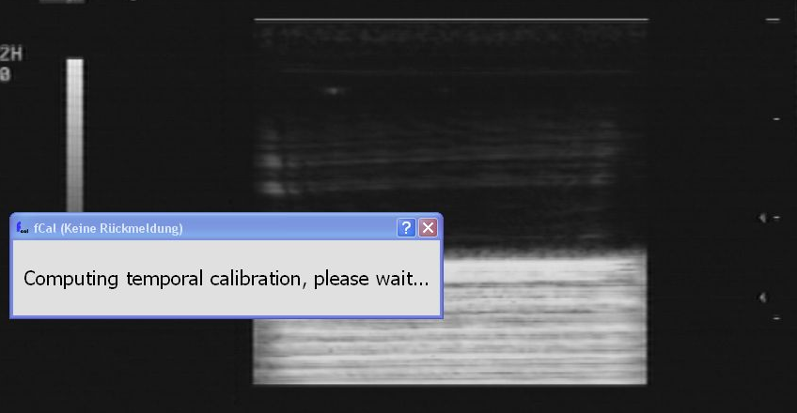
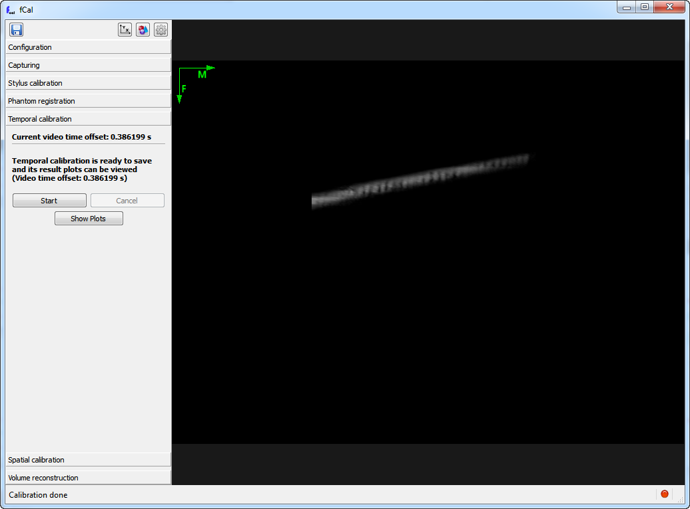
Temporal calibration
This “line” is way too thick
Nice, clearly defined line
Temporal calibration requires an image where the bottom of the water tank appears as a (not too thick) line
If the line is too thick then adjust the imaging parameters (decrease the power and gain) and/or put a diffuse reflective surface (rubber, cloth, or plastic sheet in the tank)

Slide 14
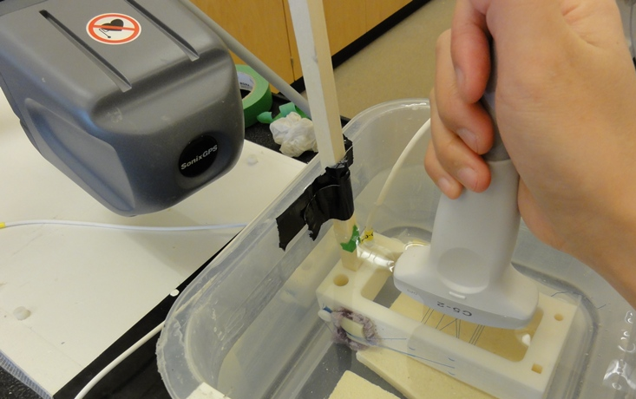
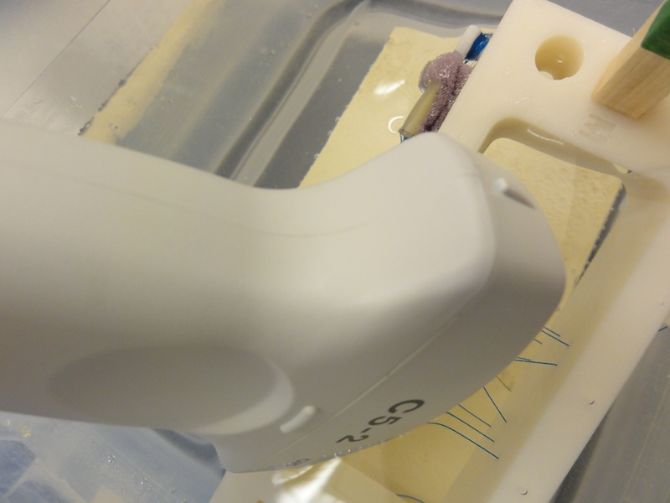
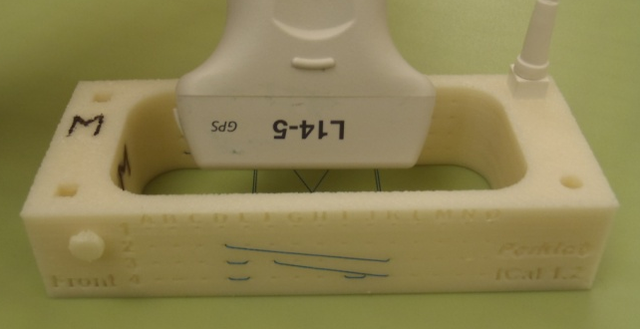
Spatial calibration
Place the phantom in the water tank
Align the transducer to have the marked side face to letter “M” on the phantom
Select “Spatial calibration”
Letter “M” marked on the phantom
Marking on the transducer

Slide 15
Spatial calibration
Select to edit parameters
Select “Region of interest” and pink frame appears on the screen. Move the probe until 9 points of wires appears on the screen.
Click “Freeze Image” then adjust the size of the frame to cover those points.

Slide 16
Spatial calibration
Set the mass candidates from “80 to 40”
Select “Spacing” to adjust the distance between points (30x20). Now the dots should be recognized and turn to green. Move the probe up-down, left-right or until the green dots appear to be stable. Then click “Apply and Close”
Click “Start” and scan the phantom in all degrees of freedom. Until the progress bar is filled. Save the calibration.

Slide 17
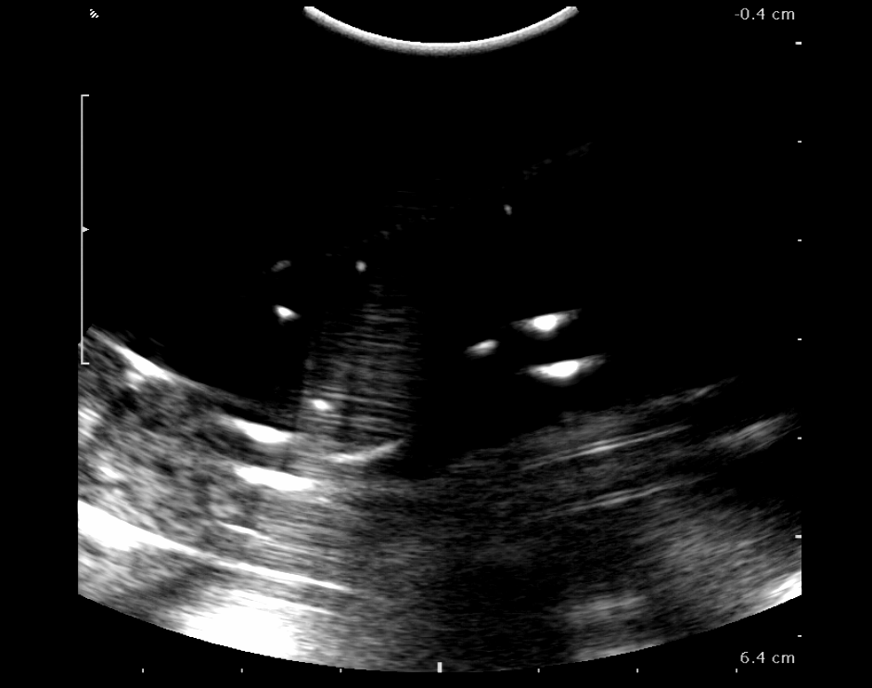
Spatial calibration
Keep the transducer's axial (direction of sound travel) axis orthogonal to the wires for optimal reflection from the wires. This dotted line should be approximately horizontal.
Fiducial line intersection points should appear as small circular-shaped blobs.
This is about OK size, but could be even smaller.
This is way too big. Decrease the gain and dynamic range.
Good fiducial size
Only the fiducials should be visible in the image, the background should be almost black.
Background is OK here.
Background is way too bright here. Decrease the dynamic range, decrease gain, adjust TGCs, increase threshold to make the background darker.
Reduce reflections by slightly changing the transducer angle or putting sound absorbing material in the water container (such as rubber or sponge).
There is a strong reflection from here that brightens up a large section of the image.

Slide 18
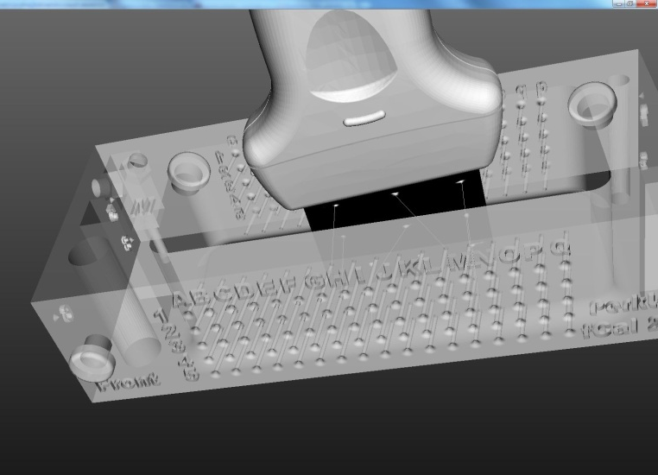
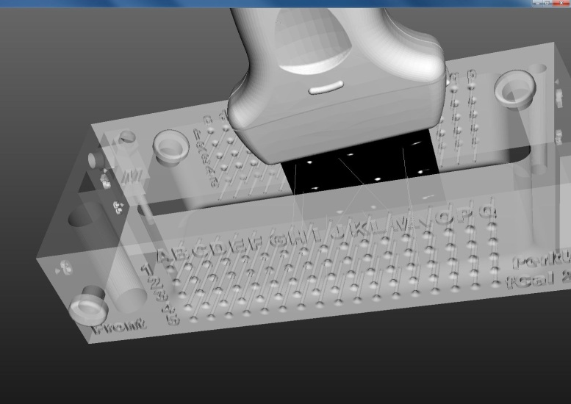
Spatial calibration
The calibration results are shown on the left side.
Select “Show all devices” to view the simulation results
Re-calibrate is the wires are not align properly.
Good Calibration
Bad Calibration

